Slide 1

PREDICTING POOREST COMMUNITIES IN
AFRICA USING SATELLITE IMAGERY
Atigon Hongchumpol
Simon Lazarus
Stanley Azuakola

Slide 2
PROBLEM STATEMENT
Client: The World Bank
Target: Anti-poverty initiative for poorest villages in Africa
Challenge: Scarcity of relevant and timely data
Can we train a model that correctly predicts the poorest villages in Africa, using publicly available satellite imagery?

Slide 3

Wealth Index

Slide 4
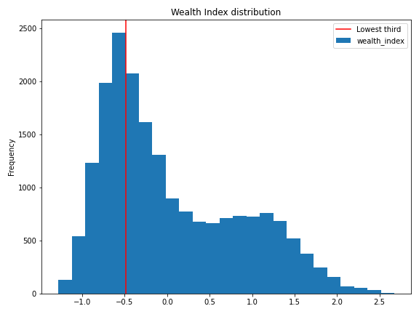

Slide 5
EVALUATION METRICS
We wanted a model that balanced these two metrics:
Accuracy:
Null Model Accuracy = 66.7%
Recall/True Positive Rate

Slide 6
Data Collection & Details

Slide 7
Wealth Index Data
Formed from Demographic & Health Surveys (DHS) data on asset wealth
Annual standardized survey in 23 African countries
Many questions about housing, water/electricity, vehicles, etc.
Results averaged across 3-year periods in specific (latitude, longitude) locations
Periods: 2009-2011, 2012-2014, 2015-2017
A “village” in our data means a 3-year aggregate of a location.
“Wealth Index” is 1st Principal Component of survey data
Data from 19,699 “villages”

Slide 8
Satellite Imagery
8 channels: 3 RGB, 3 infrared (NIR, SWIR1, SWIR2), 1 thermal (TEMP1) and 1 nighttime lights (NIGHTLIGHTS)
Images from Landsat satellite (30m/pixel resolution)
NIGHTLIGHTS images are from DMSP (2009-11) or VIIRS (2012-14) satellites and at lower resolution
1 set of six 255x255 images for each “village” (RGB channels grouped)
Pixels in each channel averaged across that village’s 3-year period
Median of all cloud-free pixel values used to create 1 composite
After removing “bad” RGB images, 19,467 villages’ worth of images

Slide 9
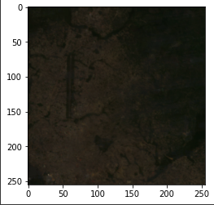
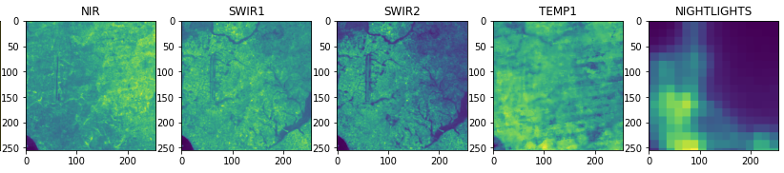
Example Imagery (1 Village in Angola)
Wealth Index: 1.88
(not in poorest third)

Slide 10
Train/Test/Validation Split
90% of observations (17,520) used as training data
5% of observations (974) used as test data
Select models on the basis of Accuracy, Recall scores on test data
5% of observations (973) used as validation data
Evaluate performance of production model vs. baseline model

Slide 11
Exploratory Data Analysis

Slide 12
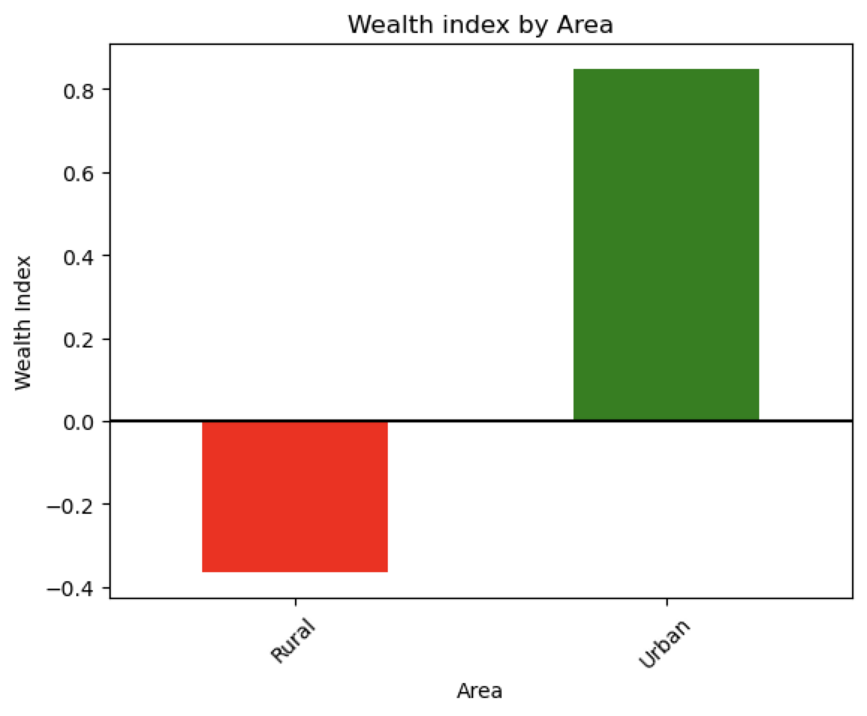
Average wealth index by living area
-People living in the Urban area has a lot of different wealth index by comparing to people who lived in the Rural area.

Slide 13
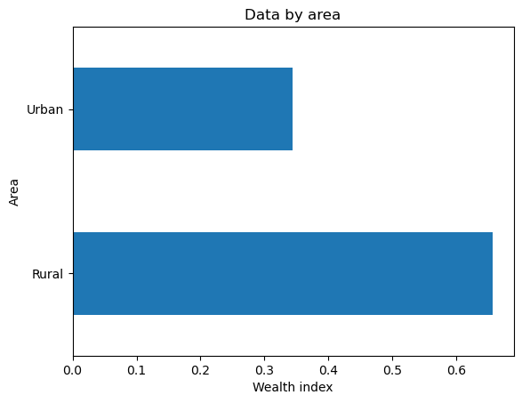
Data by area
-More data in the Rural area, the size is about double from the Urban area.

Slide 14
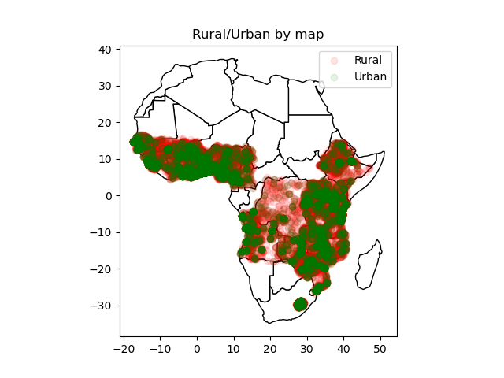
Rural / Urban map
-Green color is for the Urban area and red for the Rural area, looks like people are denser close to the coastline.

Slide 15
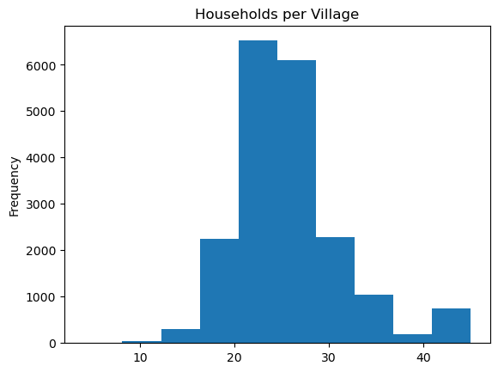
Households per village
-Average households per village is about 25

Slide 16
Baseline Model

Slide 17
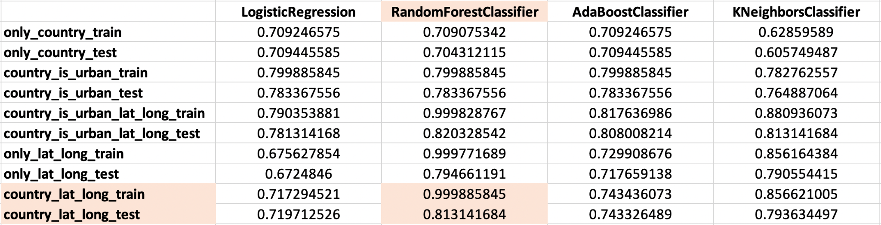
All model

Slide 18
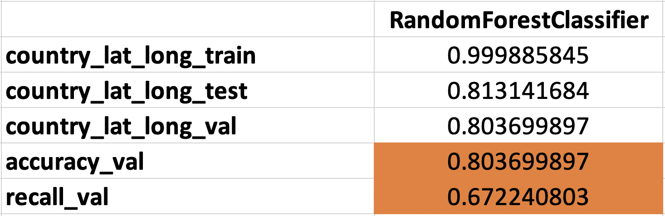
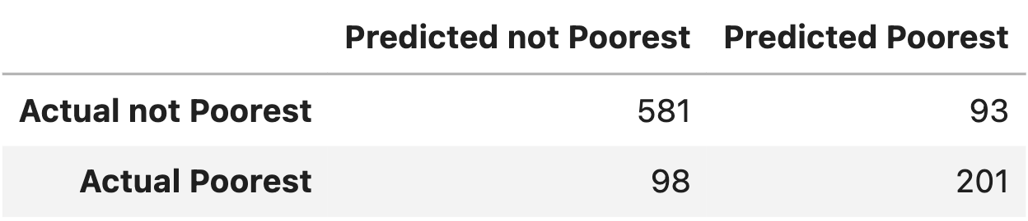
Best model score & confusion matrix

Slide 19
Neural Network Models

Slide 20
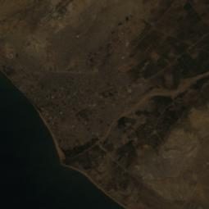
Single CNN Structure
RGB
Is this village in the poorest third of all villages? (Y/N)
EfficientNetV2M
(frozen, no top layer)
Dense output layer
Update
Prediction (probability)
Loss function (BCE)

Slide 21
NN Modeling Approach
Transfer Learning with Convolutional Neural Networks
Train one copy of EfficientNetV2M (top layer) for each image type.
6 “predictors”: RGB, NIR, SWIR1, SWIR2, TEMP1, NIGHTLIGHTS
For each village, feed the 6 predictors’ predicted probabilities as features into a top-level model (along with coordinates + country)
Train top-level models on these data (see next slide)

Slide 22
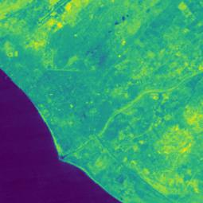
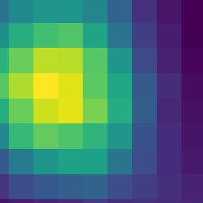
RGB
NIR
NIGHTLIGHTS
(3 other images)
EfficientNetV2M
(frozen, no top layer)
EfficientNetV2M
(frozen, no top layer)
. . .
EfficientNetV2M
(frozen, no top layer)
Dense output layer
Dense output layer
Dense output layer
Prediction (probability)
Prediction (probability)
Prediction (probability)
Final Models (Logistic Regression, Random Forest, XGBoost, etc.)
Latitude, Longitude,
& Country data

Slide 23
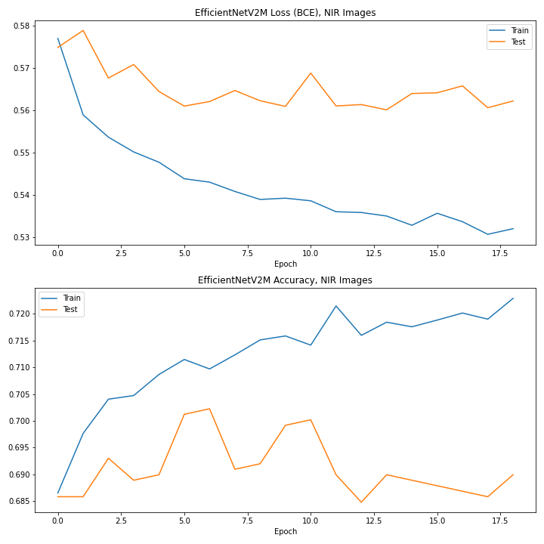
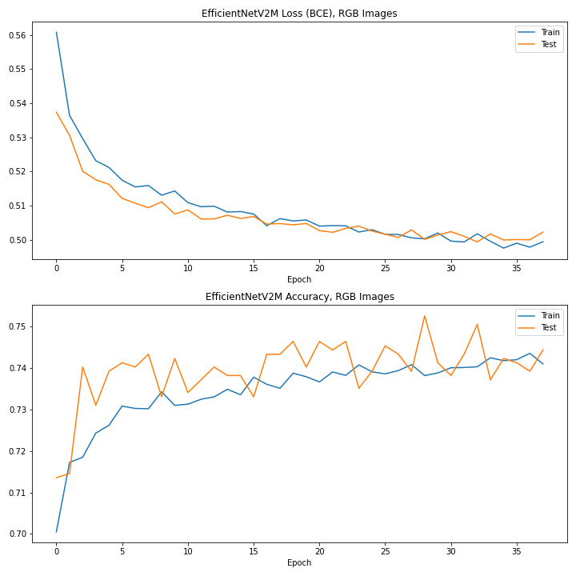
How good of predictors are the images by themselves?
NIR Test Accuracy: 69.0%
RGB Test Accuracy: 74.4%
(Null model Accuracy: 66.7%)

Slide 24
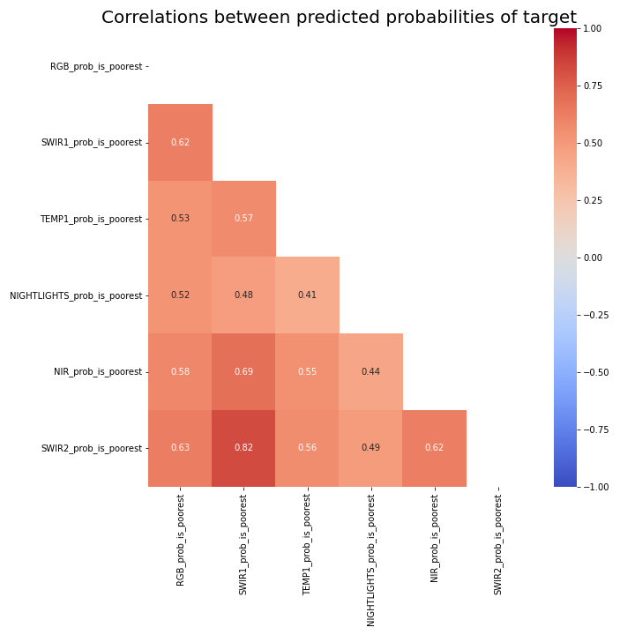
How good of predictors are the images together?
Predicted probabilites are only moderately correlated with each other
Reasons to believe that combining them will yield much better results

Slide 25
Final Models

Slide 26
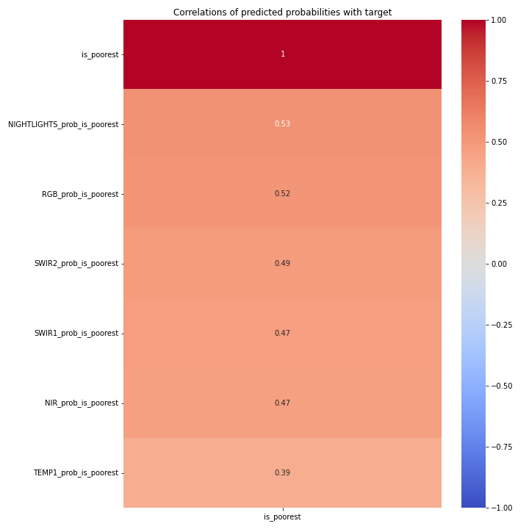
Correlations of predicted probability with target
-Not high for correlations.
-The NIGHTLIGHT has the highest.

Slide 27
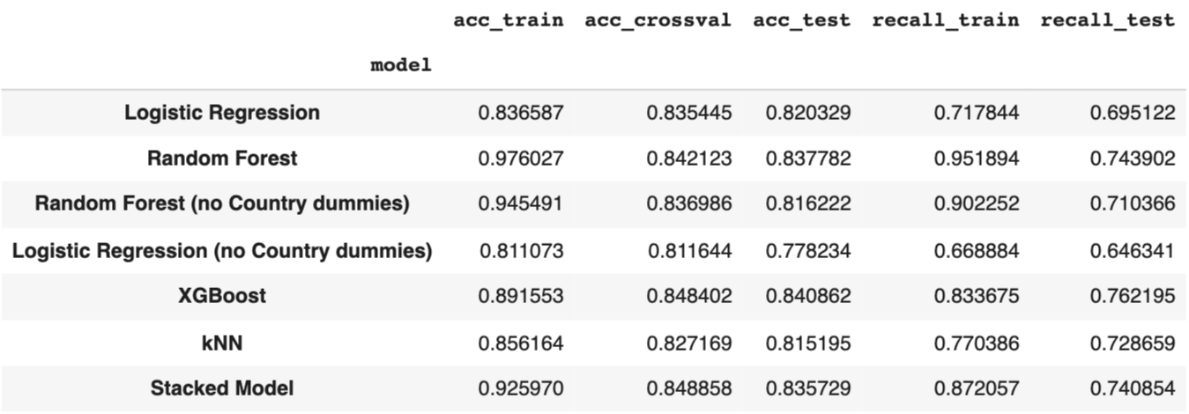
Final model
-Not using “country” does not improve models
-XGBoost performs the best

Slide 28
Analysis of Production Model

Slide 29
OUR PRODUCTION MODEL IS MORE ACCURATE AND SENSITIVE
 | NULL MODEL | BASELINE RF MODEL | PRODUCTION MODEL
ACCURACY | 66.7% | 80.4% | 85.0%
RECALL | 0% | 67.2% | 78.6%

Slide 30
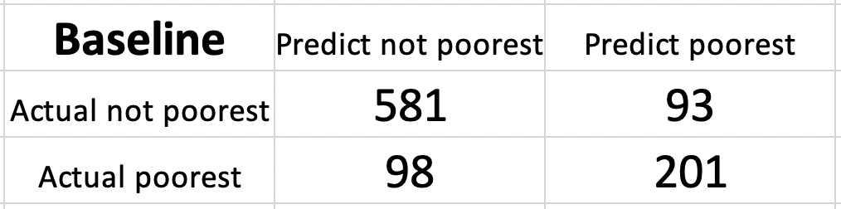
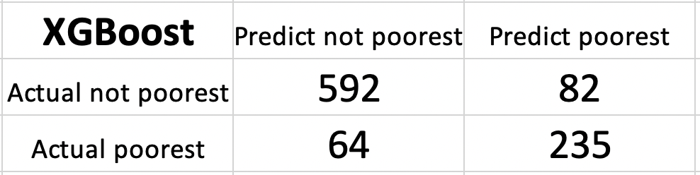
Baseline vs Production Model comparison
TN
FP
FN
TP
TN
FP
+2%
-12%
FN
TP
-35%
+17%
-Overall score improves

Slide 31
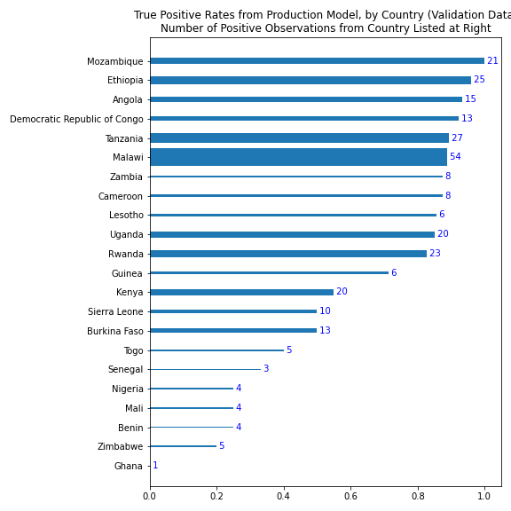
SUMMARY

Slide 32
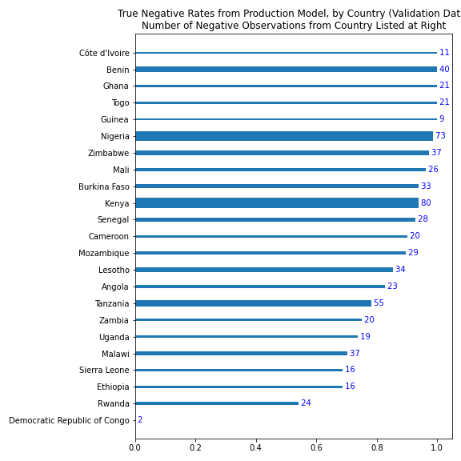
SUMMARY

Slide 33
CONCLUSION
The problem: Can we train a model that correctly predicts the poorest villages in Africa, using publicly available satellite imagery?
Our solution: YES! Using just geographic coordinates and other information that can be automatically downloaded and fed into our model - we can predict with an accuracy of 80% and a sensitivity of 78.6% whether a village in Africa suffers from extreme poverty.

